Slide 1


SocialBuzz

Slide 2


Today's agenda
Project recap
Problem
The Analytics team
Process
Insights
Summary

Slide 3

This project is for a client named SocialBuzz a newly launched social media platform.They have approached us for the following requirements :
Analysis of the most popular content posted on the platform.
Application for an IPO
An audit of big data
Project Recap

Slide 4


Problem
Problem at hand for the analytics team is to analyze the content and its type and reaction to the content posted on the platform for the most popular content and use the insights to make business decisions from the same.

Slide 5



Nidhi Kadam
(Data Analyst)
The Analytics team
Andrew Fleming (Chief Technical Architect)
Marcus Rompton (Senior Principle))

Slide 6
Process
1
Data Collection and Understanding
2
Data Cleaning and Pre processing
3
Data modelling
Obtaining insights from data
4
5
Utilizing insights to make business decisions

Slide 7

Insights
How many unique categories are there?
16 unique categories are there.
How many reactions are there to the most popular category?
1897 unique reactions are there.
What was the month with the most posts?
January

Slide 9
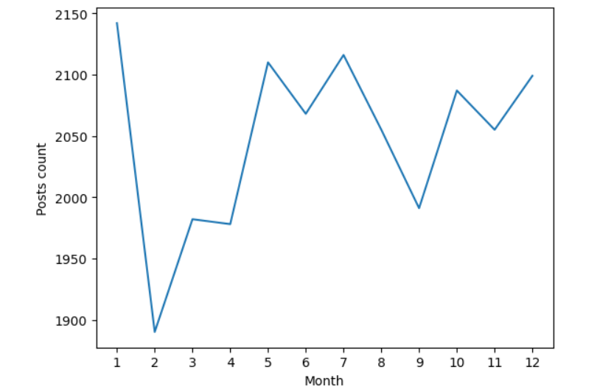

Slide 10

Hence it can be concluded from the above slides that animals was the most popular category and has received all kinds of reactions, with most posts posted in the month of January hence the same category can be emphasized on to get more popularity in the sector.
Summary

Slide 11

Thank you!
ANY QUESTIONS?

